Slide 1
An Introduction to RNA-seq data analysis
Qiang Wang
5/7/2020

Slide 2
Contents
Prerequisites
SLURM-scripts
Python language and packages
R language and packages
Anaconda to manage different environments
RNA-seq data analysis pipeline
Tools
Example
Notes:
In transcriptomics, the study of the total set of RNAs transcribed by the cell, RNA sequencing (RNA-seq) has become the standard tool for analyzing gene expression.

Slide 3
HPC System
ssh <user>@hpcgateway7.pennstatehealth.net
log on to HPC
sinfo – check the system information
 | Compute | GPU | High-Density
CPU | 44 cores/88 threads | 44 cores/88 threads | 44 cores/88 threads
RAM | 384GB | 384GB | 1.5TB
GPU | None | 2x Nvidia P100 16GB | 4x Nvidia V100 32GB

Slide 4
Basic Commands on HPC
squeue : view job and job stem information for jobs managed by Slurm
scancel <job_id> : cancel the job started by yourself
salloc -p compute : request an allocation
srun --pty bash : launch a pseudo terminal
srun <command> : run command in a job
sbatch <script> : submit and run script on HPC
exit : exit current environment

Slide 5
Write a Slurm script - steps
create a Slurm script locally from a template
modify the job name, variables, commands and parameters
ssh logon to HPC gateway
salloc and srun to start a pseudo terminal
verify the commands
copy the commands back if need change
upload the script to HPC (scp)
sbatch to submit the job
scancel and repeat from step 4 if there is any error

Slide 6
Python language and packages
Python is powerful... and fast; plays well with others; runs everywhere; is friendly & easy to learn; is Open.
There are many tools build with Python, especially for data science:
Pandas: an open-source Python package that provides high-performance, easy-to-use data structures and data analysis tools for the labeled data
NumPy: an efficient container of generic multi-dimensional data
SciPy: contains modules for efficient mathematical routines as linear algebra, interpolation, optimization, integration, and statistics
Matplotlib: to visualize data
Seaborn: an extension of Matplotlib with advanced features

Slide 7
R language and packages
R is a language and environment for statistical computing and graphics
It is widely used in some subjects like statistics and biostatistics
There are bunch of R packages for data import, wrangling and visualization:
dplyr: The essential data-munging R package when working with data frames. Especially useful for operating on data by categories
data.table: quick aggregation of large data
ggplot2: Powerful implementation of the grammar of graphics visualization
and more

Slide 8
Bioconductor
Bioconductor provides tools for the analysis and comprehension of high-throughput genomic data.
Bioconductor uses the R statistical programming language, and is open source and open development.
There are a lot of useful tools and pipelines released in Bioconductor.
https://www.bioconductor.org/

Slide 9
Anaconda to manage different environments
Anaconda is a free and open-source distribution of the Python and R programming languages for scientific computing
aims to simplify package management and deployment
The distribution includes data-science packages suitable for Windows, Linux, and macOS.

Slide 10
RNA-seq data analysis

Slide 11
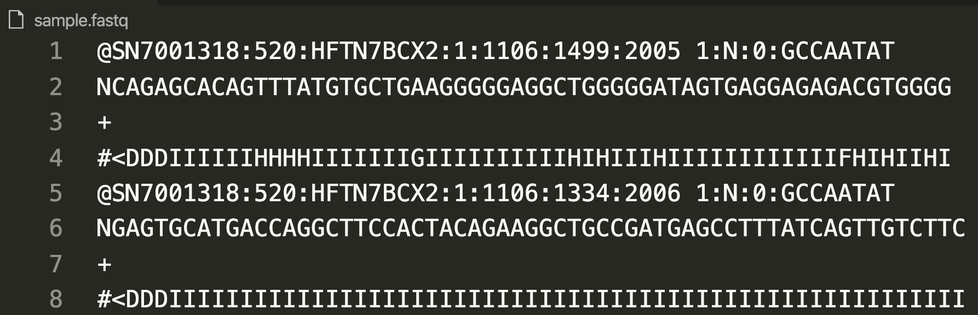
Raw data – fastq and sra
https://en.wikipedia.org/wiki/FASTQ_format
the Sequence Read Archives (SRA) is a raw data archive, and requires per-base quality scores for all submitted data. SRA accepts binary files such as BAM, SFF, and HDF5 formats and text formats such as FASTQ.
use sra tools to fetch or convert the raw data.

Slide 12
Quality assessing - FastQC
https://www.bioinformatics.babraham.ac.uk/projects/download.html#fastqc

Slide 13
Mapping reads to the reference genome
Tools:
hisat2: http://daehwankimlab.github.io/hisat2/
tophat: https://ccb.jhu.edu/software/tophat/index.shtml
and more for mapping
samtools: a suite of programs for interacting with high-throughput sequencing data http://www.htslib.org/
Input: fastq files
Output: sorted BAM files
Stats:
9606312 reads; of these:
19606312 (100.00%) were unpaired; of these:
437243 (2.23%) aligned 0 times
13535342 (69.04%) aligned exactly 1 time
5633727 (28.73%) aligned >1 times
97.77% overall alignment rate

Slide 14
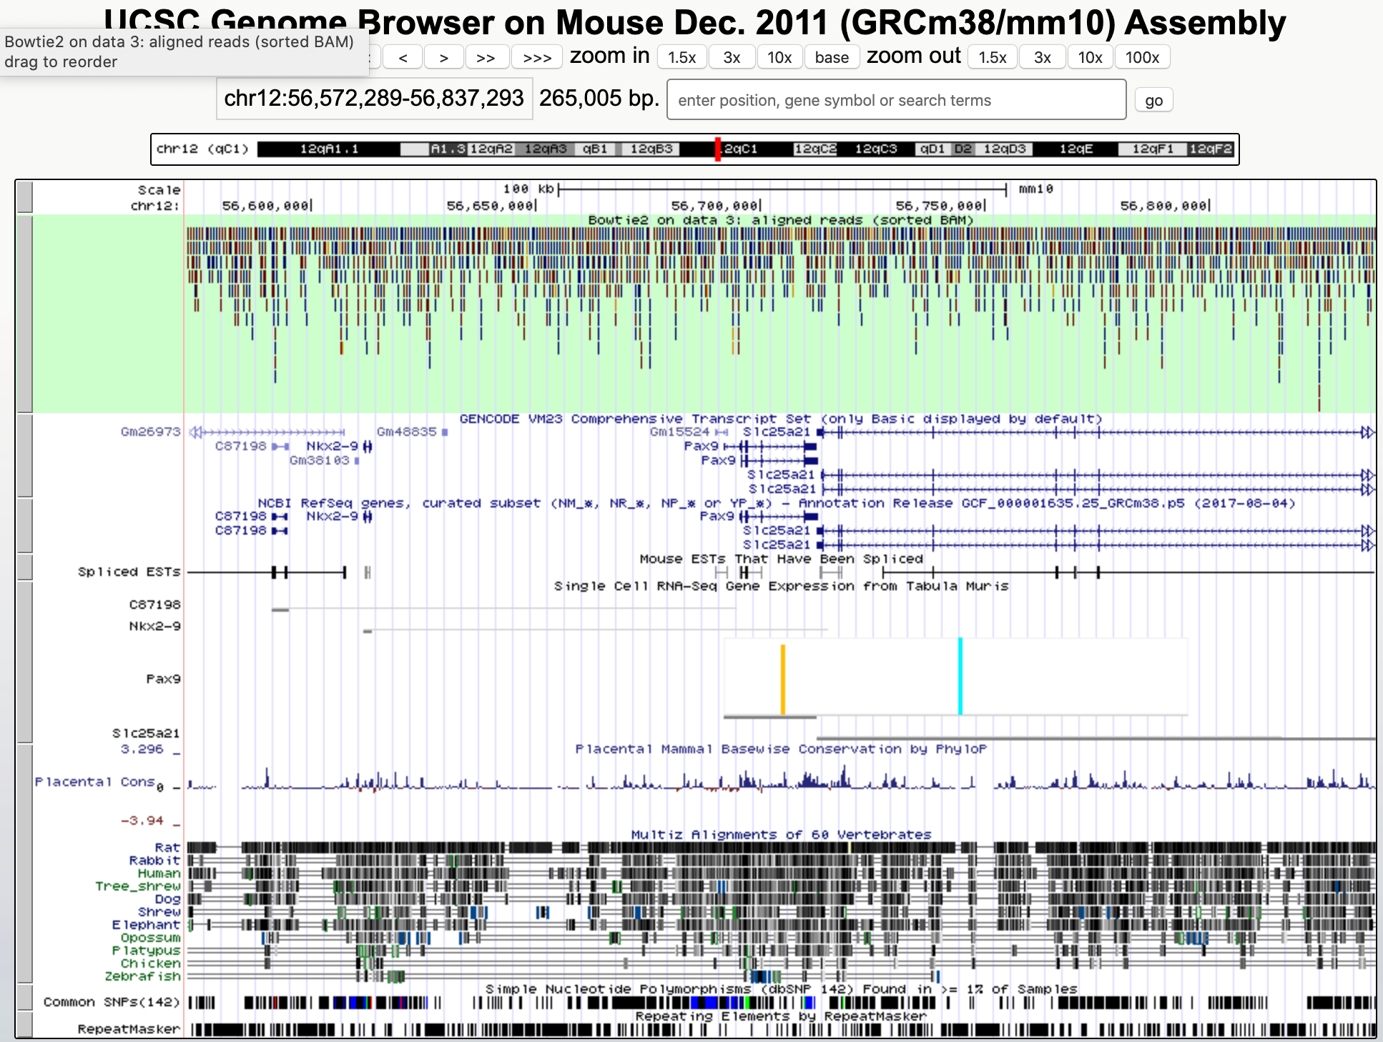
View the mapping result
UCSC browser:

Slide 15
Transcriptome assembly
Tools:
Cufflinks: http://cole-trapnell-lab.github.io/cufflinks/
Input: aligned_reads.(sam/bam)
Output files:
Transcriptome assembly: transcripts.gtf
Gene-level expression: genes.fpkm_tracking
Transcript-level expression: isoforms.fpkm_tracking

Slide 16
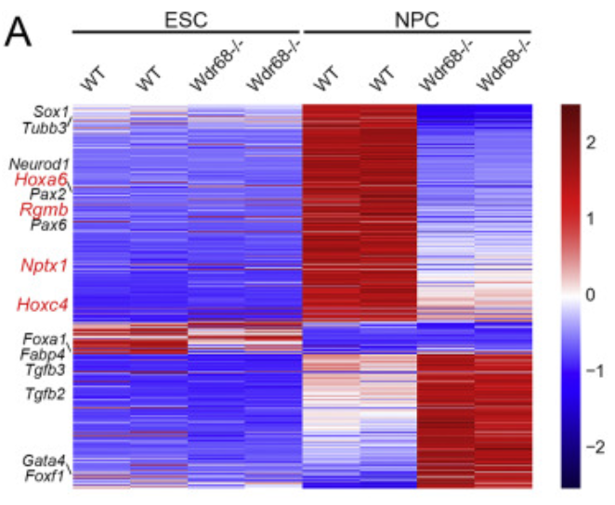
Downstream analysis
Heatmap of transcriptomic analysis
(Seaborn – a Python package)
Sample distances ( DESeq2 – an R package)

Slide 17
Thanks

